Slide 1
Worthwhile or wasteful: Understanding the value of external confirmations
The Digitisation Wave–
Is your firm prepared?
Fernando Lopez-Fando | 21 March 2019

Slide 2
Digitisation vs Digitalisation: What is the difference?
Digitisation : Process of converting information into a digital format
Digitalisation : The integration of digital technologies into everyday life.

Slide 3
What Digitalisation Can Bring to the Table?
Operational efficiencies
Utilise the power of data
Future-proof with standard technology

Slide 4
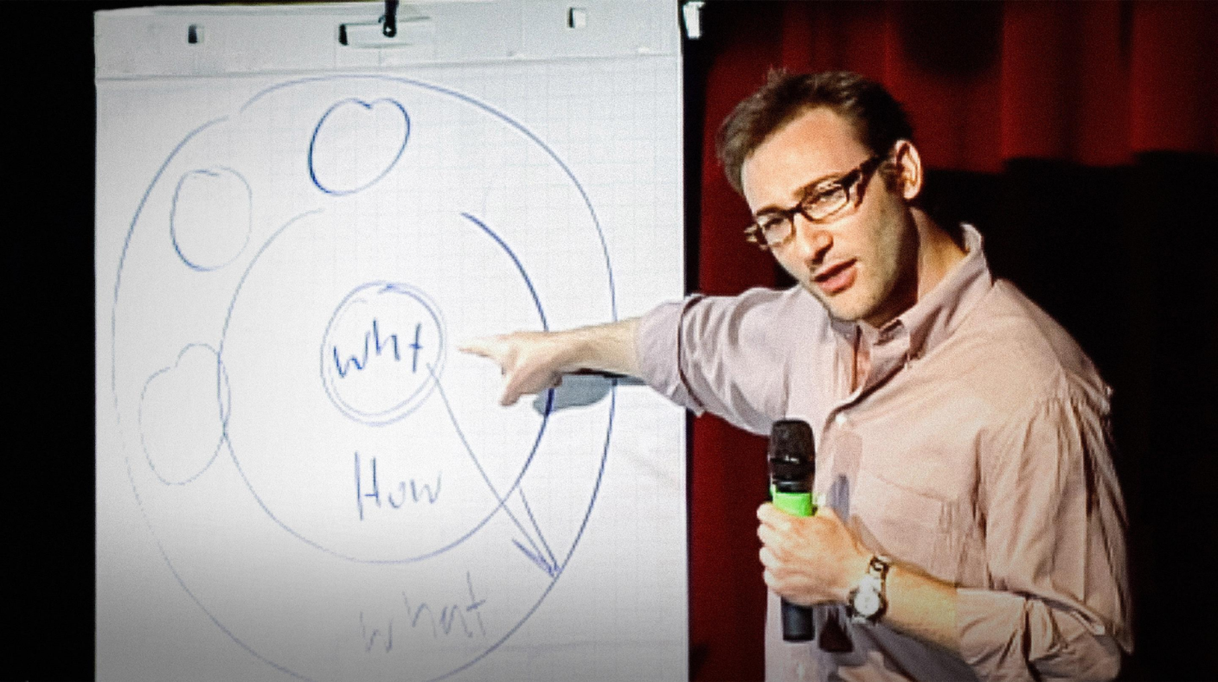
Why Technology Matters?
The WHY
Everything ties back to the customer experience

Slide 5
What is the end goal?
Enhance the Customer Experience
Direct
Indirect
Front-end
Back-end

Slide 6
Current and Future Technologies

Slide 7
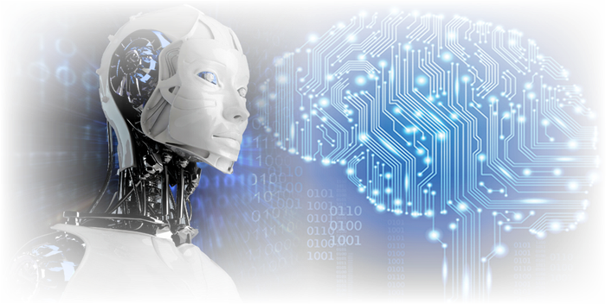
Current and Future Technologies
“AI is simply the task of getting computers and machines to do the tasks that require intelligence when done by humans.” - ICAEW
AI and Robotics

Slide 8
Current and Future Technologies
Data Analytics

Slide 9
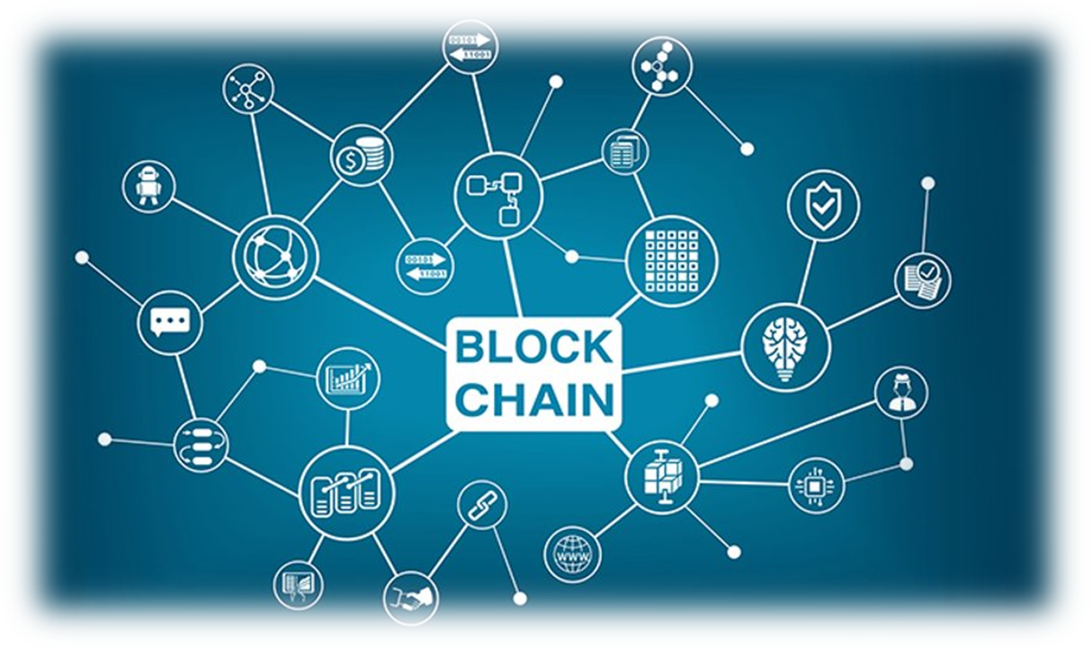
Current and Future Technologies
Distributed Ledger Technology

Slide 10
There have been waves of change and hype in technology
Automated
Cloud
Artificial Intelligence
DLT
BIG FOUR
PROJECTS
All are great examples of digitisation & digitalisation

Slide 11
Understand, Adopt, Lead
Understanding – Still learning discovery phase​
Adopting – Starting to implement digitalization across your organisation​
Leading – You are ahead of the curve of digitalisation
Understand
Adopt
Lead

Slide 12
“Where is there room for Digitalisation in the Audit Process?”

Slide 13
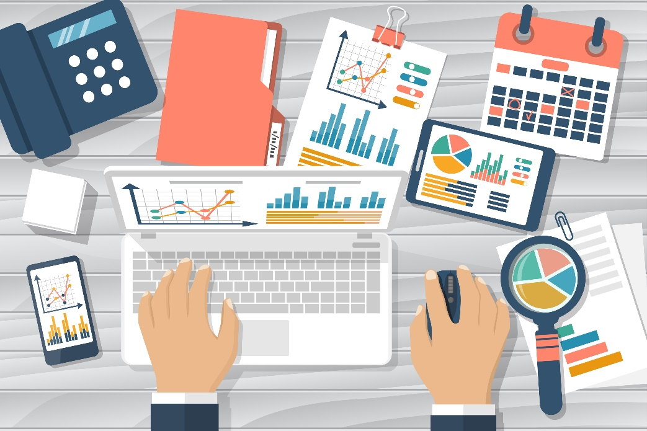
Data Analysis and Collection in Audit
Testing Complete Data Sets
Simulation and Modelling
Automated Collection Techniques

Slide 14
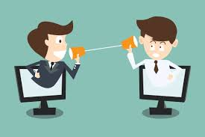
Communication in Audit
Internal Communication
Process improvement
External Communication
(Automated communication workflows)

Slide 15
Data Protection and Security
DLT Technologies
Automated Data Handling Processes

Slide 16
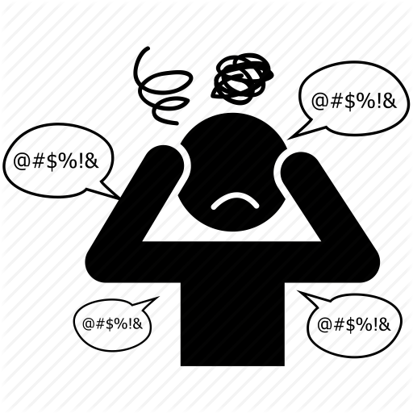
Why Should You Care?
“But I can live without making my firm’s processes easier?”
Changing competitive landscape
Regulation
Fewer grey hairs

Slide 17
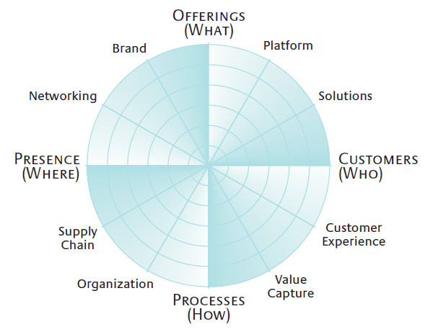
What can you do today?
Start simply
Develop a digital philosophy
Think broadly about innovation and maintain an open-mind approach
Innovation Radar

Slide 18
Discussion

Slide 19
Presented by Confirmation
Fernando Lopez-Fando
Business Development Manager, Spain & Portugal
Fernando.lopez-fando@confirmation.com
+34 667 518 009

